Slide 1


INDUSTRYº
INSTAGRAM
UPGRADE
WWW.ENGLISHPROJECT.ES

Slide 2
INDEX
01
02
03
04
05
06
07
New Ideas
Reason for the changes
Old Instagram Shop
IInterface & Design
Goals
Conclusion
Our Team

Slide 3

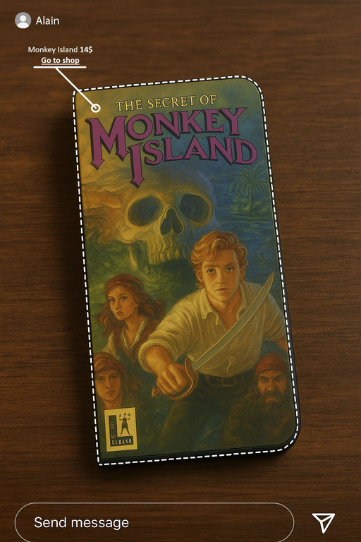
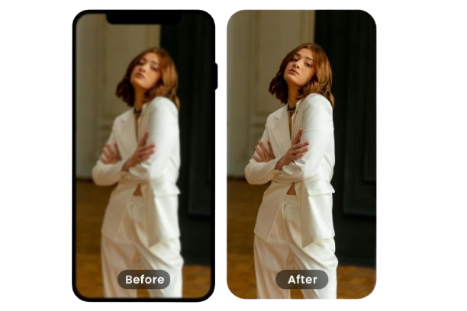
NEW IDEAS
Instagram Shop 2.0
The first idea was to recreate a store within Instagram, to facilitate the sale of products, and thus centralize more areas in our app.
Stories Improvement
The second, although less interesting, was to give everyone the option of not losing quality in the stories if you didn't have an iPhone.

Slide 4
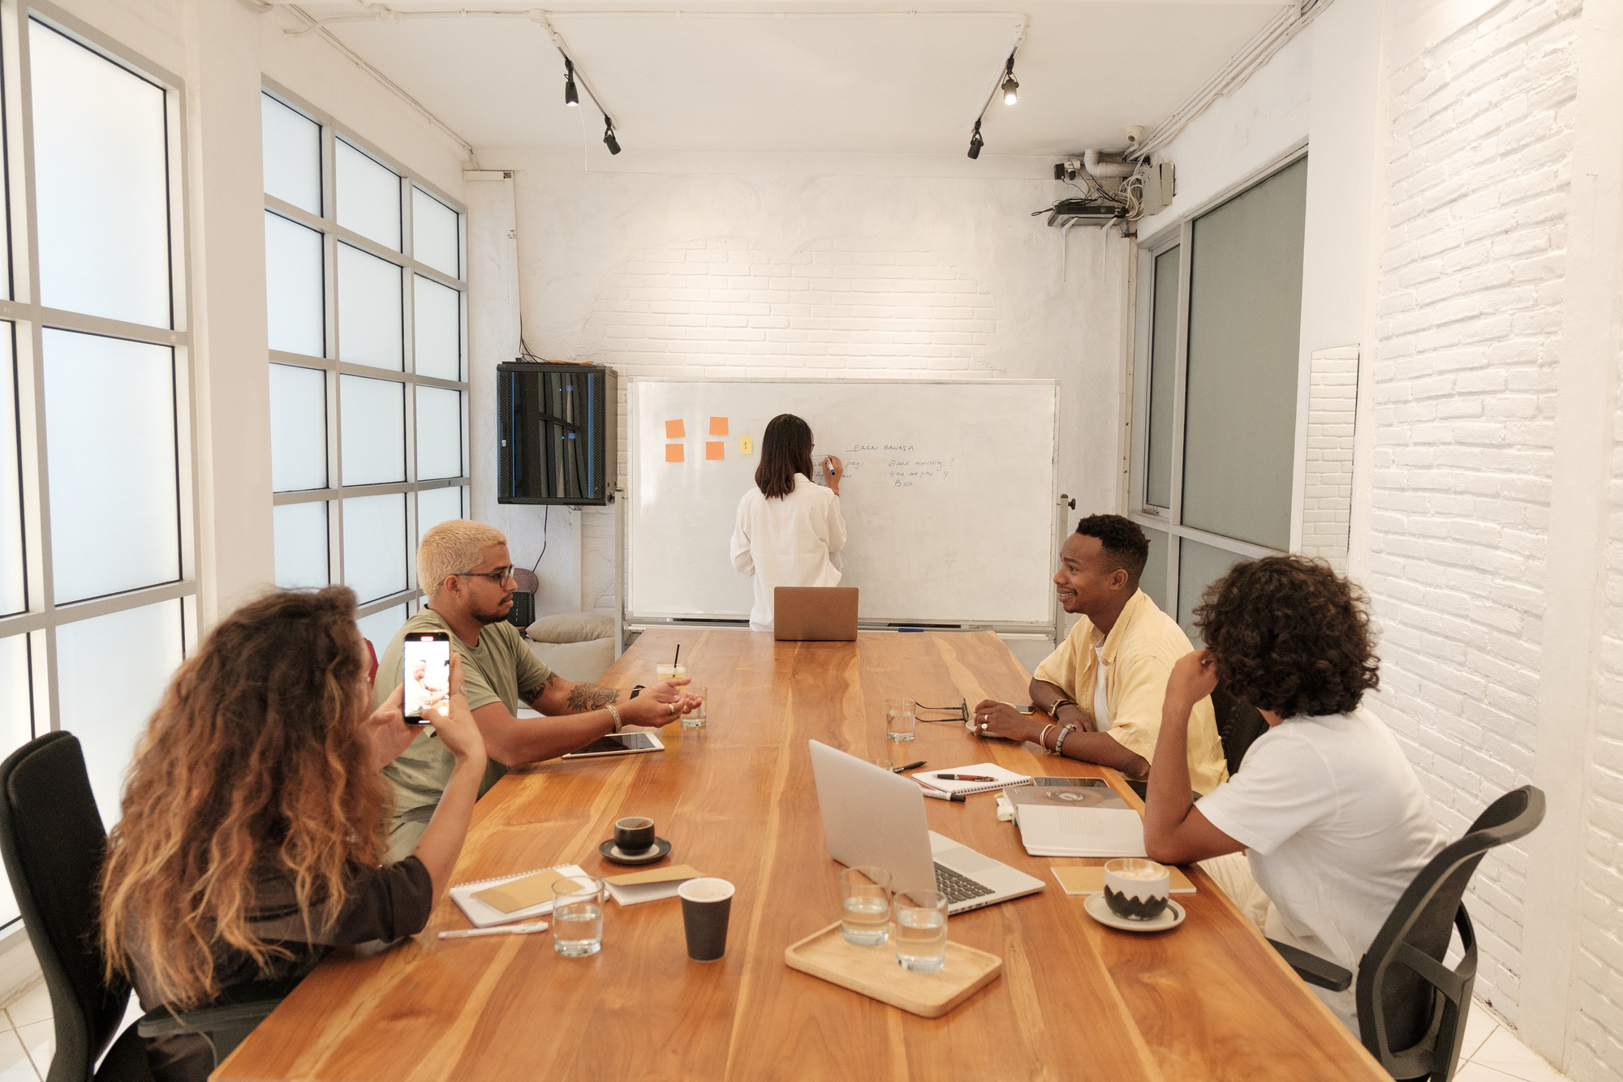


REASONS
Instagram can provide more features for its users or small businesses to be more visible, using his own market place just as Facebook and TikTok do.
The very low quality of the storyes on Android devices
makes the users that makes content change to iPhone or use other apps to record

Slide 5
OLD INSTAGRAM SHOP
What was Instagram Shop?
How did it work
Instagram Shop was a feature that allowed brands and creators to sell products directly on Instagram. Users could browse catalogs, view product details, and make purchases without leaving the app.
Businesses connected their Instagram account to a product catalog via Facebook or Shopify. Users could tap product tags in posts or stories to see prices, descriptions, and buy through Checkout or the seller’s website.
Disappearance
Timeline
2020
2020-2023
2023
Instagram removed the “Shop” tab to focus on content, Reels, and ads. In-app shopping generated less revenue than advertising, so Meta prioritized its main monetization channels.
Shop Tag Added
Active time
Shop Tag Removed

Slide 6
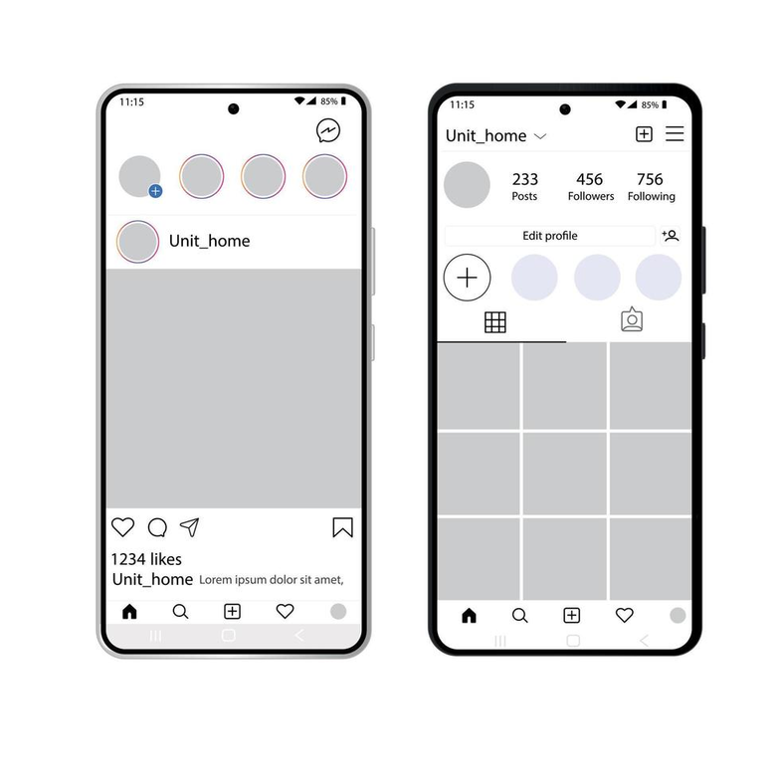
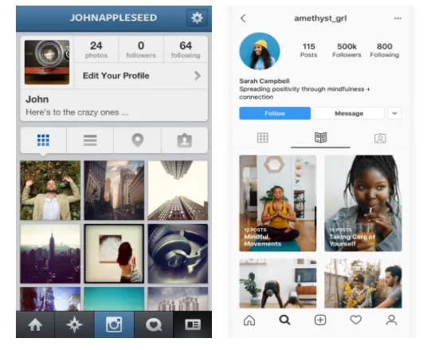
INTERFACE & DESIGN

Slide 7




GOALS
Increase
Earnings
User compliance
Instagram is a constantly growing platform, and we aim to be useful to as many people as possible.
We believe that this way, the shop will make buying more comfortable and we would make people stay for more time
Because we care about our users and we want to improve their experience wihtout worrying about their mobile model.

Slide 8




CONCLUSION
Improve the experience
Save our users time and give them security
Give our users a space and a facility to advertise and make small artists known
EXPERIENCE
TIME
VISIBILITY

Slide 9
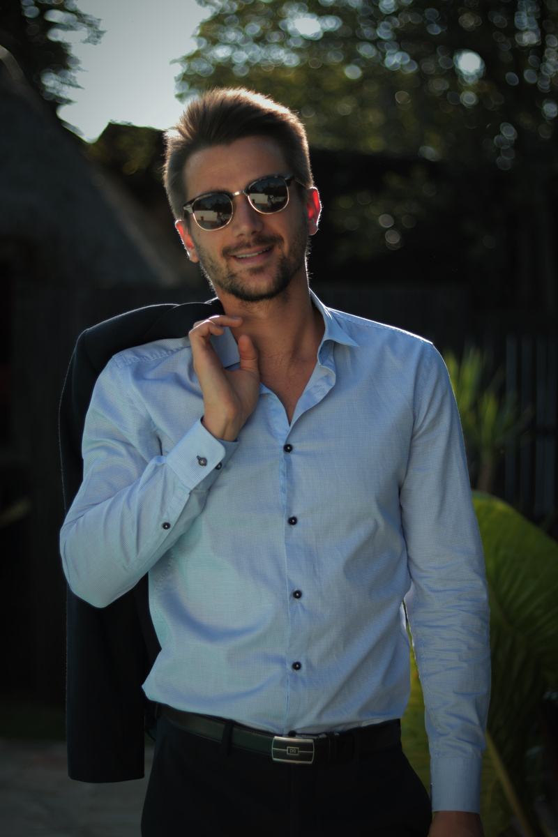
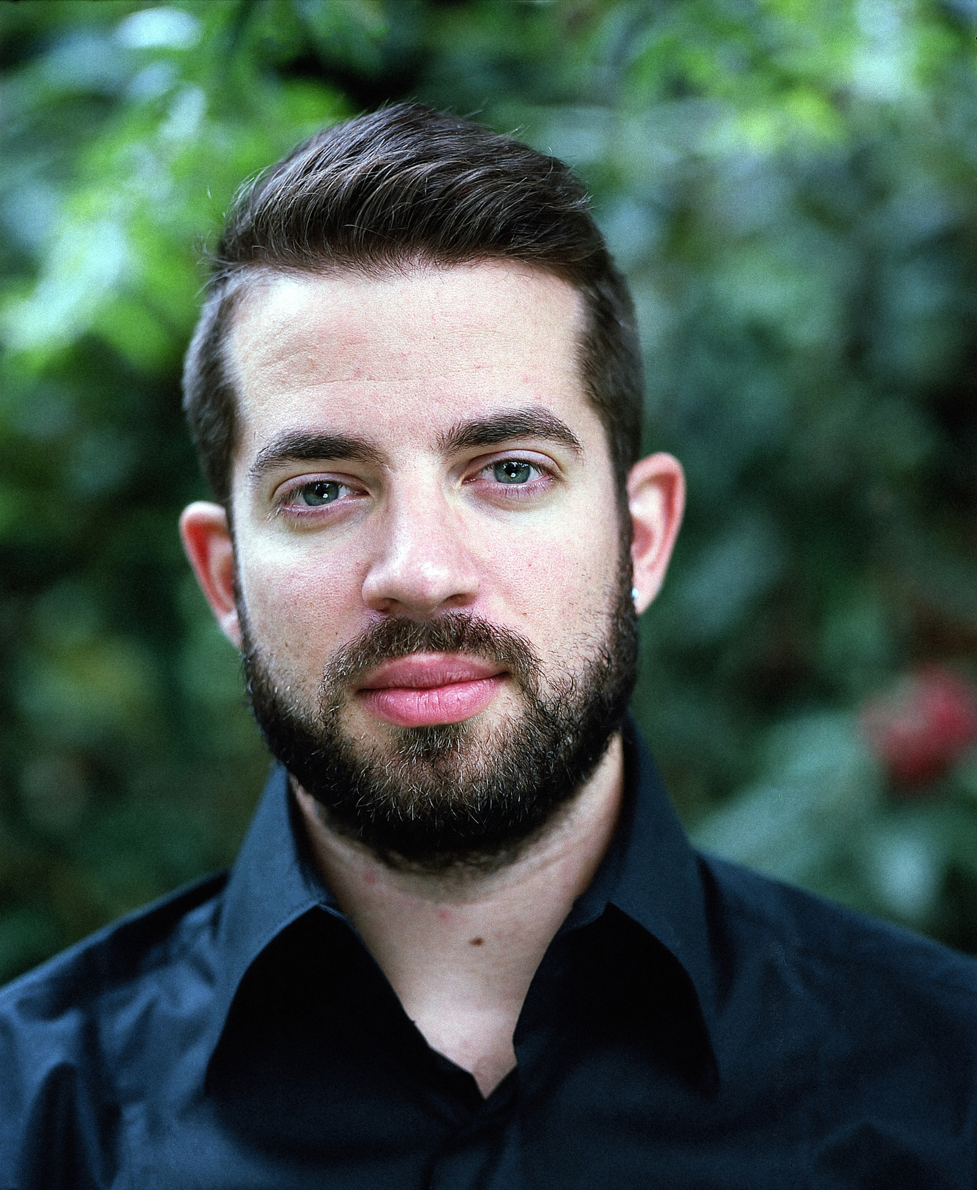
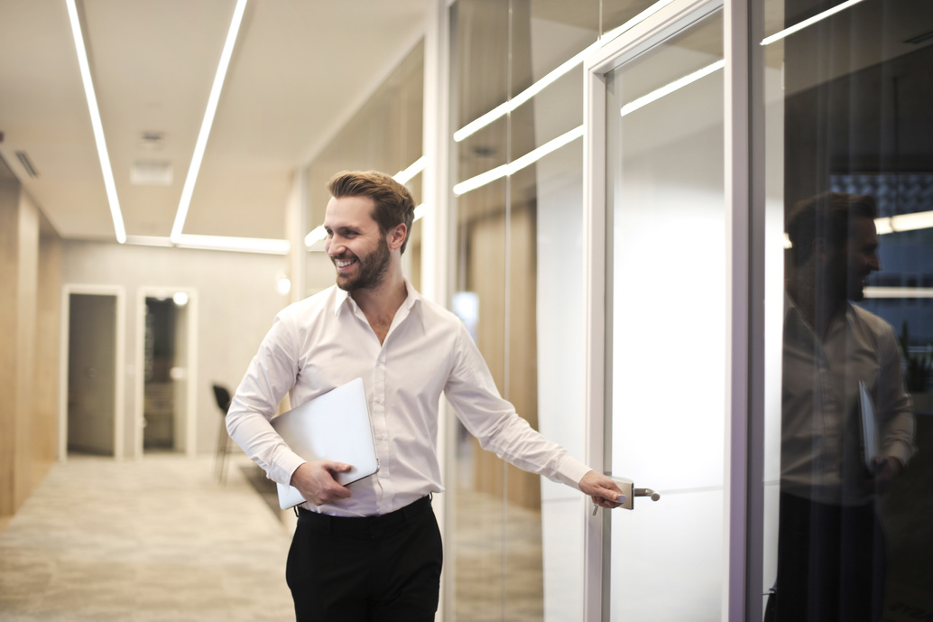
OUR TEAM
Samuel Hernández
David Rdríguez
Iker Aimar
Marketing
Finanzas
Contabilidad

